Slide 1
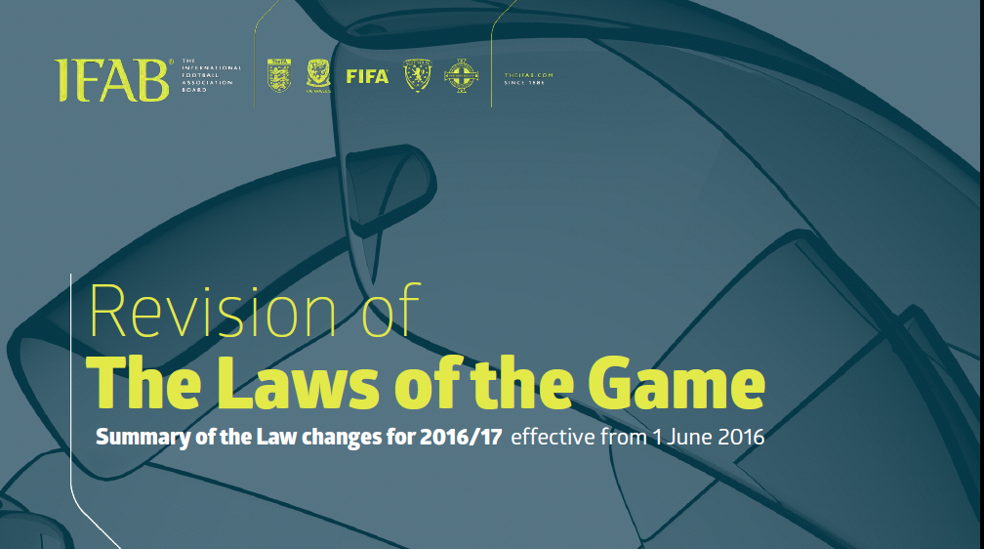
With Emphasis on changes important for AYSO games
Charlie Roxlo, Region 64 DRI – charles.roxlo@finisar.com - http://www.ayso2j.org/referee

Slide 2
Our Objective Today
This year the IFAB made the most substantial revisions to the laws of the game in its 135-year history
AYSO will be applying the 2016-17 laws this season
Today we will review the most significant changes for AYSO games. Emphasis will be on games from U10 through U14.
All referees should do their best to apply the new laws, to ensure a uniform and accurate application in our region and elsewhere

Slide 3
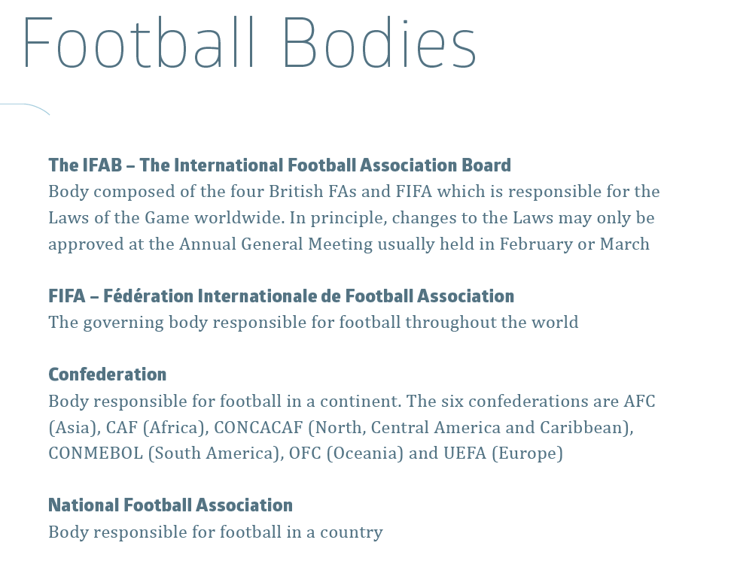
USSF – United States Soccer Federation
AYSO – American Youth Soccer Organization
Section 2
Area 2J
Region 64
AYSO follows IFAB laws, and AYSO National Rules & Regulations
              USSF

Slide 4
Purposes of current Law revisions
“...the aim of the revision is to make the Laws of the Game more accessible and more easily understood by everyone in football and increase consistency of understanding, interpretation and application.”
Simpler structure – combined law and interpretation
Updated titles – e.g. Law 6, “Other Match Officials”
English and phraseology – remove repetitions and contradictions.
Updated content – there are some significant changes in how laws are to be applied and interpreted
Overall the LOTG are shortened from 22,000 to 12,000 words. There are new sections to explain the changes to the LOTG.
LOTG: http://www.theifab.com/#!/document. See p. 110 for complete list of changes
Q&A: http://www.theifab.com/#!/laws/additional-explanatory-documents/chapters/download-explanatory-documents

Slide 5
Some changes are not critical in AYSO
Use common sense when enforcing laws intended for very competitive, adult matches
  Flag markings
  Commercial markings on field
  Hybrid field surfaces
  Color of players’ socks and undergarments
  Additional assistant referees, goal line technology, video replay
  Player leaving the field after assessment for injury
  Ejections before entering the field

Slide 6
Simplification, example

Slide 7
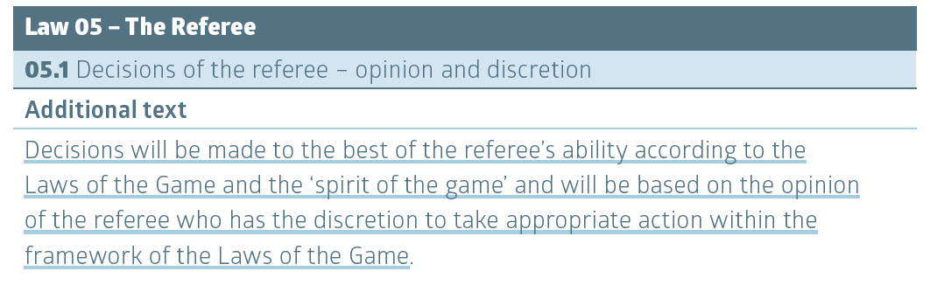
Simplification, very important
Removes multiple references to “in the opinion of the referee”
“Spirit of the game”: e.g. fairness, game flow and sportsmanship
“Framework of the laws”

Slide 8
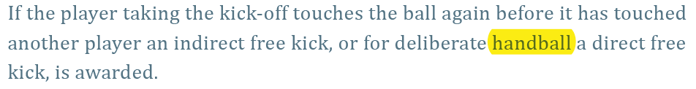
Simplification, my favorite
Law 8
The previously-forbidden (by some) word “handball” is now allowed

Slide 9
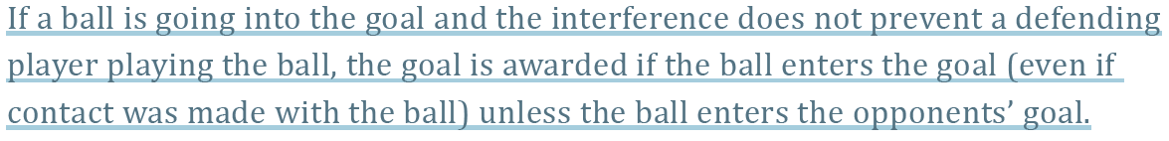
Law 3 – The Players
Interference with play by a substitute, substituted player, team official, or outside agent
Examples
Substitute or spectator coming onto the field
Substitute or another team kicking a second ball onto the field

Slide 10
Law 5 - Referee’s signal for advantage
Can be applied with one hand if that makes it easier for the referee to run on the field

Slide 11
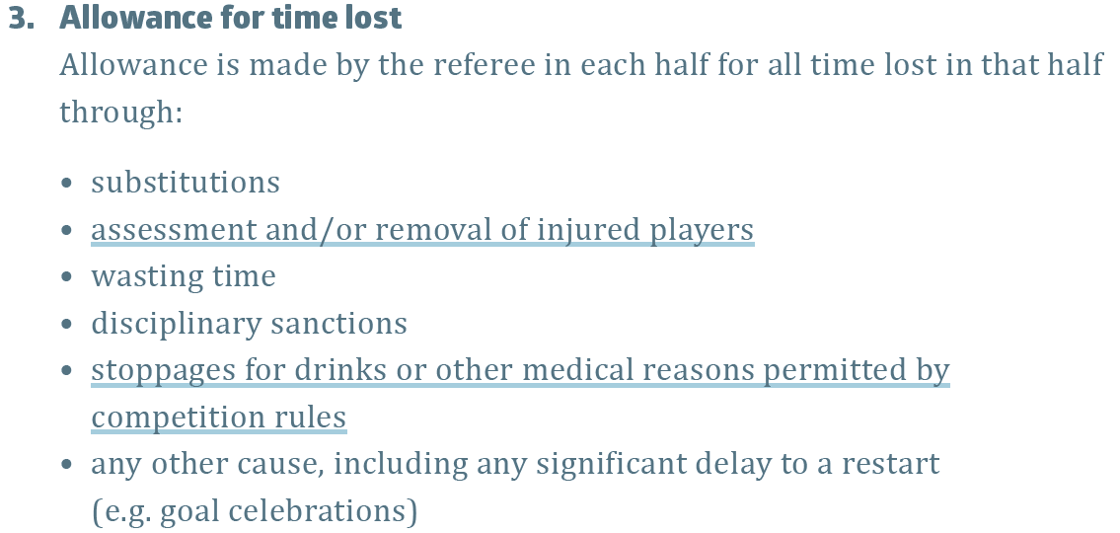
Law 7 – The duration of the match
You must add time; do not add too much time

Slide 12
Law 8 – The start and restart of play
For every kicked restart:
The ball is in play when it is kicked and clearly moves
  Ball movement should be visible to all
  This applies to free kicks, corner kicks, etc.
  Clear movement is required to prevent unsporting actions, as sometimes used on corner kicks
Kickoffs may be kicked backwards
Penalty kicks must still be kicked and clearly move forward
Kicks by defending team in their penalty area, such as goal kicks, are in play when they leave the penalty area

Slide 13
Law 8 – The start and restart of play
Dropped ball
Apply within framework of the laws and according to spirit of the game. Use common sense.

Slide 14
Law 11 - Offside
Restart occurs where the attacking player becomes involved in play, not where she was at the time the ball was touched by a teammate
Generally, assistant referees no longer have to run upfield to signal position after raising the flag for offside

Slide 15
Deliberate Heading Infraction
To prevent concussions and possible life-long injury, USSF has prohibited heading of the ball for players Age 10 and under
Enforce in all AYSO games starting Fall 2016
Meaning of “Deliberate” similar to “deliberate handling of the ball”
Applies to all players in U12 and younger games (two-year age groups)
Sanction is Indirect Free Kick
  Location of IFK per Law 13: normally from point of infraction
Deliberate heading infraction is not a foul or misconduct
  Not eligible for persistent infringement, DOGSO or USB misconducts
  Advantage can be applied, e.g. defender scoring own goal by heading
https://section2refadmin.wordpress.com/under-age-heading/ and AYSO NR&R

Slide 16
Law 12 – Fouls and Misconduct
RESTARTS UNDER OLD (2015-16) LOTG:
Fouls must be committed:
    While the ball is in play
    By a player
    Against an opponent (including handball)
    On the field of play
Direct free kicks and penalty kicks are awarded only for direct free kick fouls
IFK restarts for other infractions by players while ball is in play
Restarts for offenses committed while ball is out of play are according to the original reason for stopping play
Dropped ball for offenses committed by non-players (generally)

Slide 17
Law 12 – Fouls and Misconduct
RESTARTS UNDER NEW (2016-17) LOTG:
Fouls must be committed:
    While the ball is in play
    By a player
    Against an opponent (including handball)
    On the field of play Players can commit fouls off the field of play
Direct free kicks and penalty kicks are awarded only for direct free kick fouls
IFK restarts for other infractions by players while ball is in play
All fouls that involve contact have DFK/PK restarts
Restarts for offenses committed while ball is out of play are according to the original reason for stopping play
Dropped ball for offenses committed by non-players
Substitutes, substituted players, and team officials can commit offenses resulting in DFKs/PKs.
Offenses committed by players against teammates and officials can result in DFKs/PKs.

Slide 18
Law 12 – Fouls and misconduct
New DFK foul: impeding an opponent with contact
Restated IFK foul: impeding the progress of an opponent without any contact being made

Slide 19
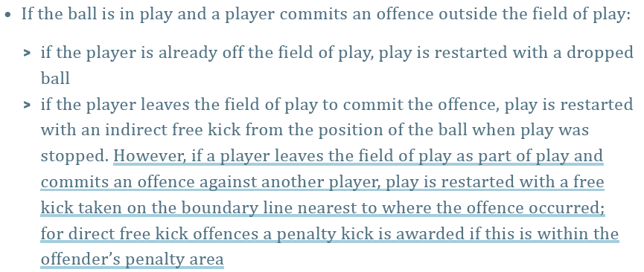
Law 12 – Fouls and misconducts
Example:
Defender holds opponent off the field but inside goal → penalty kick

Slide 20
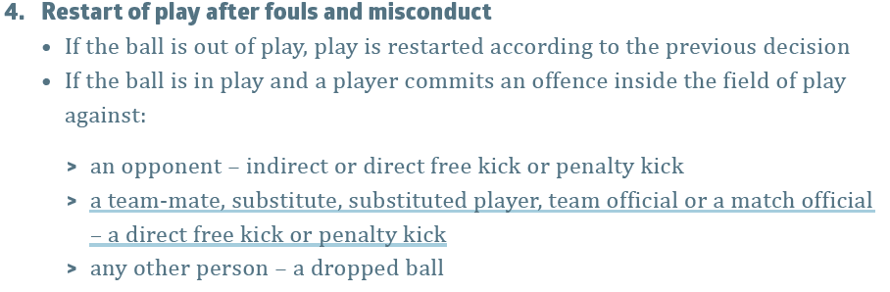
Law 12 – fouls and misconducts
Examples:
Defender strikes referee in Penalty Area → PK
Defender kicks teammate in Penalty Area → PK
Defender dissents in penalty area → still IFK

Slide 21
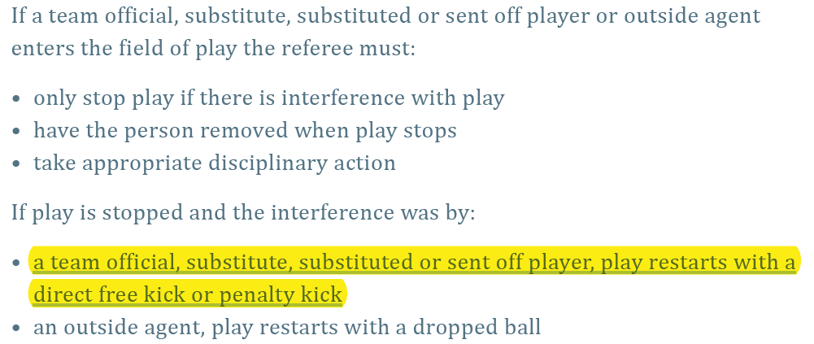
Law 3: The Players
Examples:
- Substitute enters field over goal line → DFK or PK
- Coach intercepts ball at touch line → DFK

Slide 22
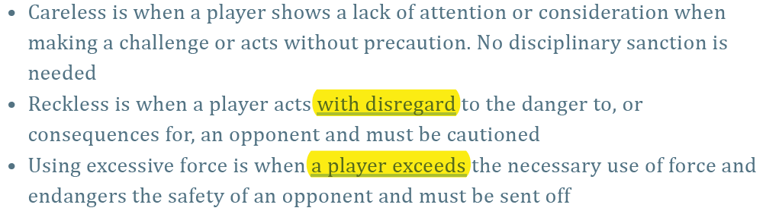
Law 12 – Fouls and Misconduct
New foul definitions
Clarified conditional DFK foul:
  Tackles or challenges
Revised conditions for DFK fouls:

Slide 23
Law 12: “Triple penalty” DOGSO
PK foul which is a play for the ball, but denies a goal is now a USB yellow card
Does not apply to DOGSO for IFK offense

Slide 24
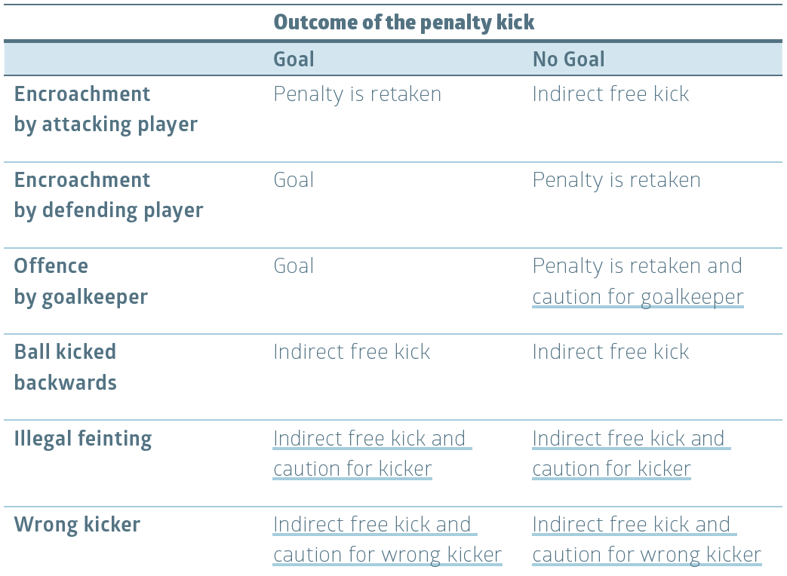
Law 14 – Penalty kicks

Slide 25
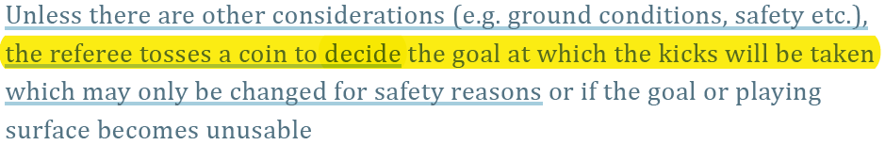
Law 10 – Determining the outcome of a match
Kicks from the penalty mark
“Reduce to equate” applies both before and during KFTM. Note that there are more cautions now during KFTM (Law 14).

Slide 26
Summary: Most important law changes to apply in AYSO
Law | Change | Age
None | Deliberate Heading Infraction | U8-U12
8 | Kickoff may be kicked backwards | U8+
5 | Decisions in opinion of ref, in spirit of game, within framework of the laws | U8+
11 | Offside IFK restart at position of involvement in play | U10+
3 | Can allow goal after interference | U12+
8 | Kicked restarts are in play when ball clearly moves | U14+
12 | New restarts for infractions off-field and by non-players | U16+
14 | Penalty kick cautions; No triple-penalty DOGSO; new KFTM procedures | U16+
Does not include clarifications, or changes consistent with prior AYSO practice

